Slide 1

Commands and Events
CIDM 6330
Spring 2021

Slide 2

Commands
APP Chapter 10

Slide 3
Commands are Imperatives
Event
Something happened
Broad audience
Commands
I intend that something will happen
Directed audience
Respond accordingly
Separate command handling from event handling

Slide 4
An Event-Driven Architecture
Chapter 11

Slide 5
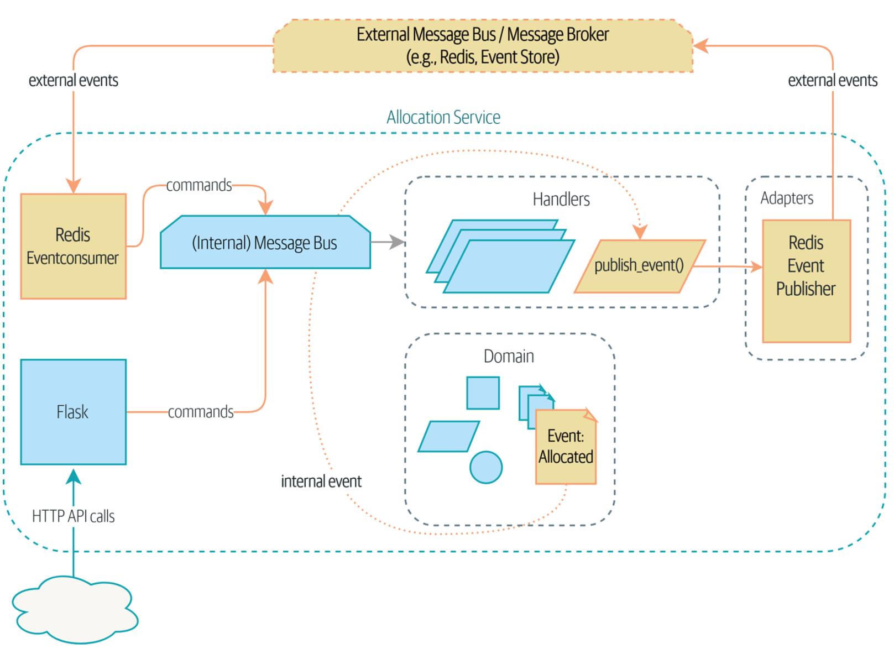
A Message Processor of Events

Slide 6
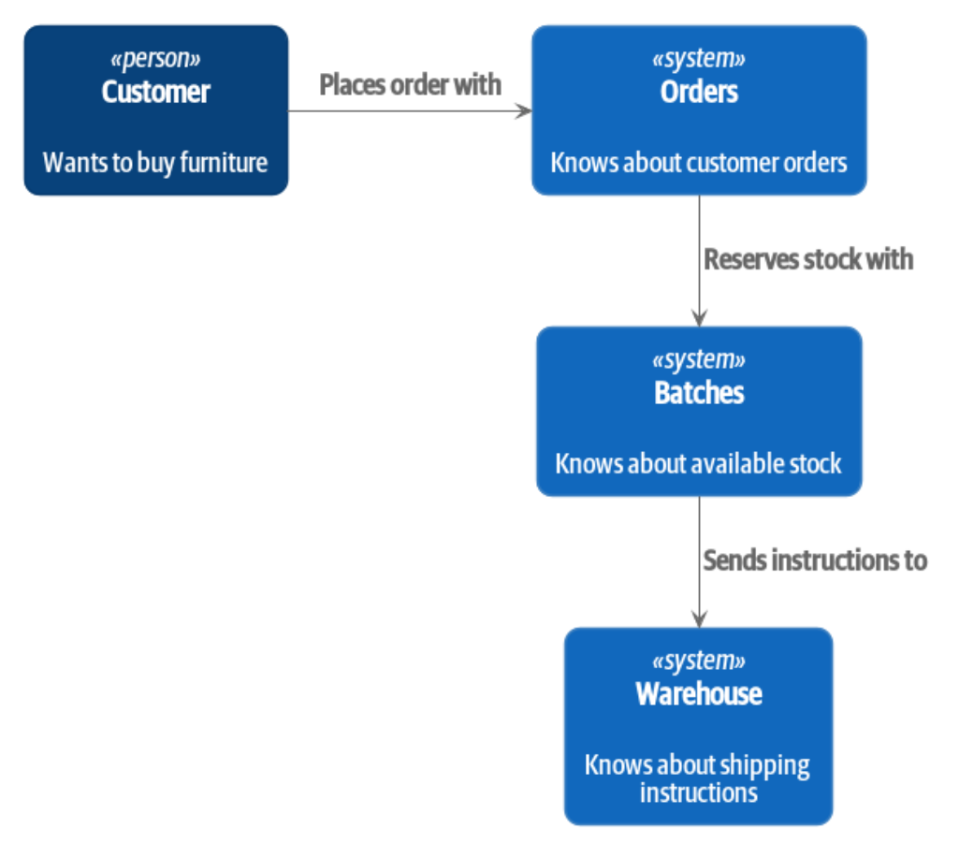
A Microservice?
There isn’t a precise definition save for:
Single-Responsibility
Often HTTP-based
Often event-driven
An orchestration of Nouns?
Transactions between them are Microservices

Slide 7
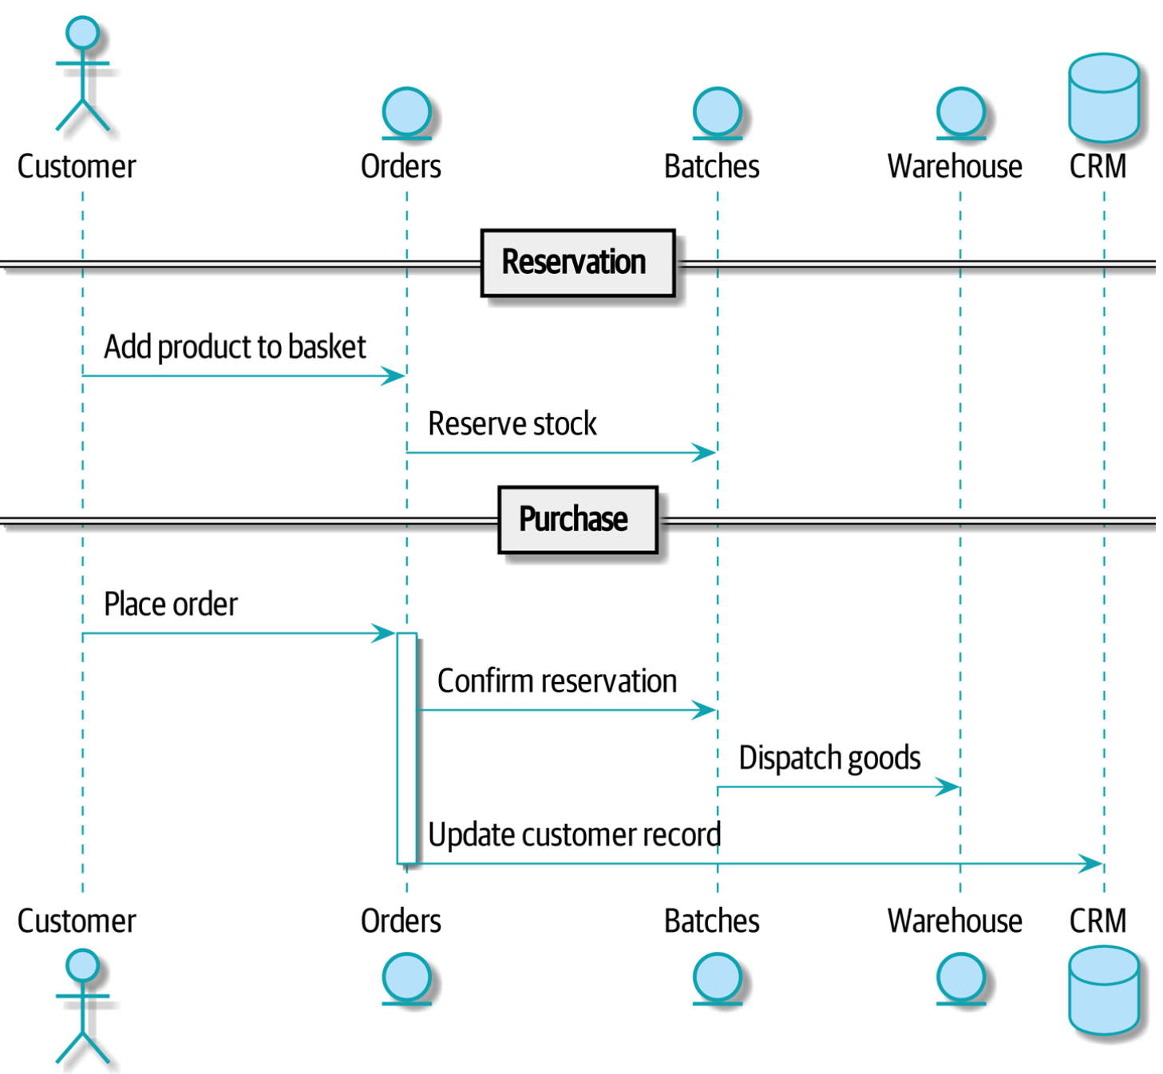
Common Noun-oriented Approach

Slide 8
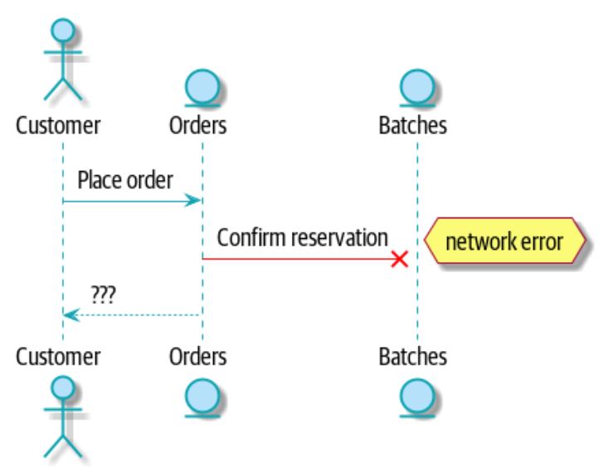
Coupling and Connascence
When things break, coupling presents problems
Connascence == “co-evolution”
Coupling is ephemeral and can be
strong/weak
loose/tight
Connascence becomes another quality metric

Slide 9
A Verb-Centric Approach
A domain model is a model of verbs
Actions change state
This clarifies responsibility
Responsibility creates consistency boundaries
A microservice emits events based on received commands which request action
Commands and Events are assumed to be processed asynchronously
Needed: Message Queueing

Slide 10
A Pub/Sub Message Queue
A message broker extends a message bus to become a message broker between microservices
Match publishers with subscribers
Common Tools:
Apache Kafka, RabbitMQ, or Redis

Slide 11
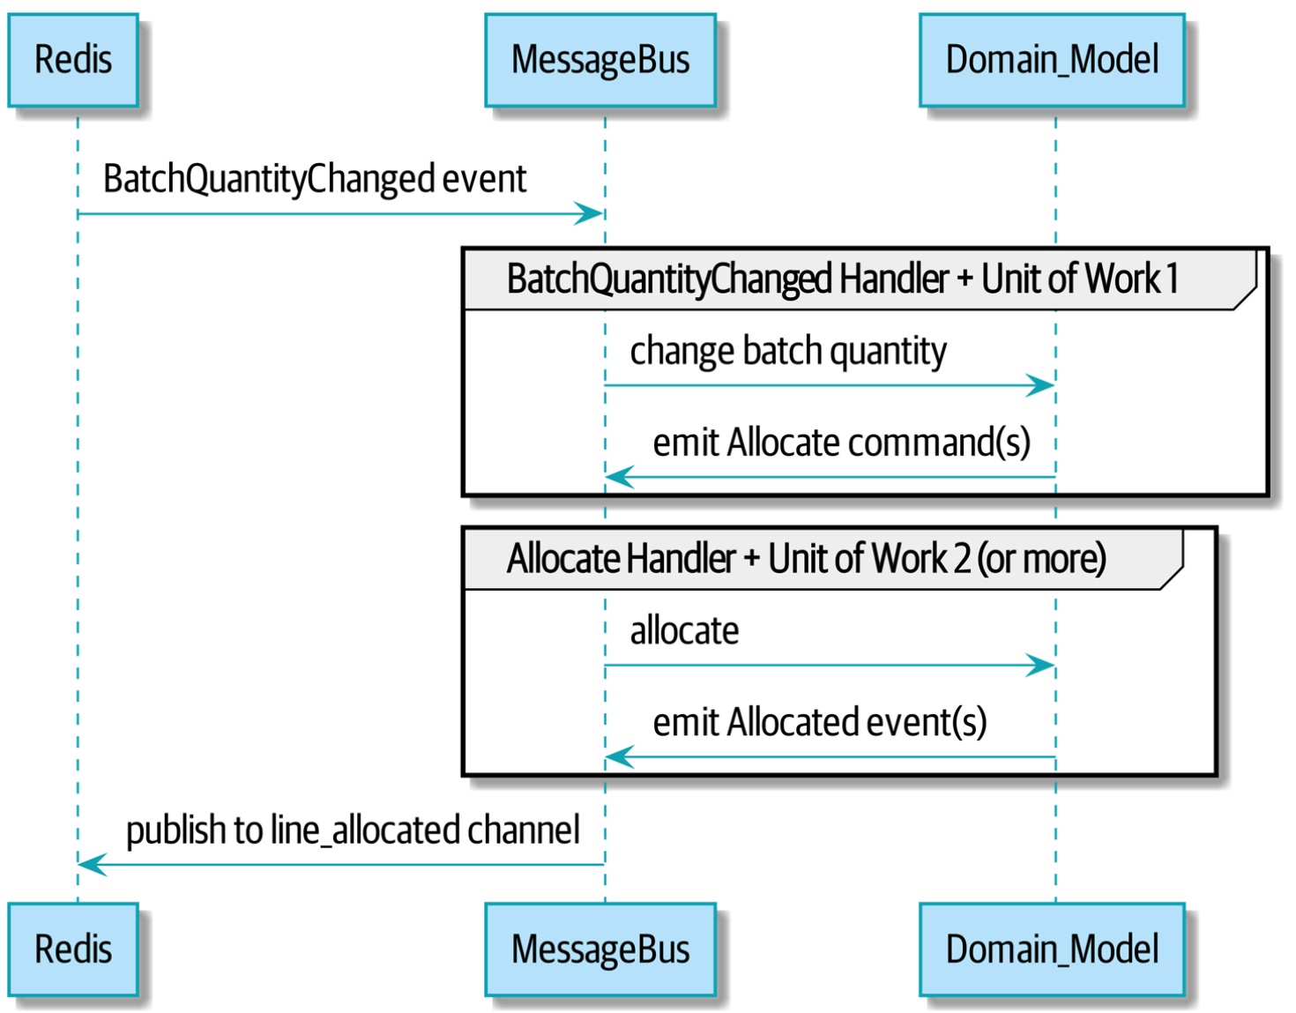
A Message Queue Approach

Slide 12
Redis Pub/Sub
“Redis pub/sub listener (we call it an event consumer) is very much like Flask: it translates from the outside world to our events…”
A microservice/verb-orientation suggests that we need event/messaging:
Internally - often immediate/synchronous
Externally - asynchronous
“Event notification is nice because it implies a low level of coupling, and is pretty simple to set up. It can become problematic, however, if there really is a logical flow that runs over various event notifications...It can be hard to see such a flow as it's not explicit in any program text....This can make it hard to debug and modify.” -Martin Fowler

Slide 13
Command-Query Responsibility Segregation (CQRS)
Chapter 12

Slide 14
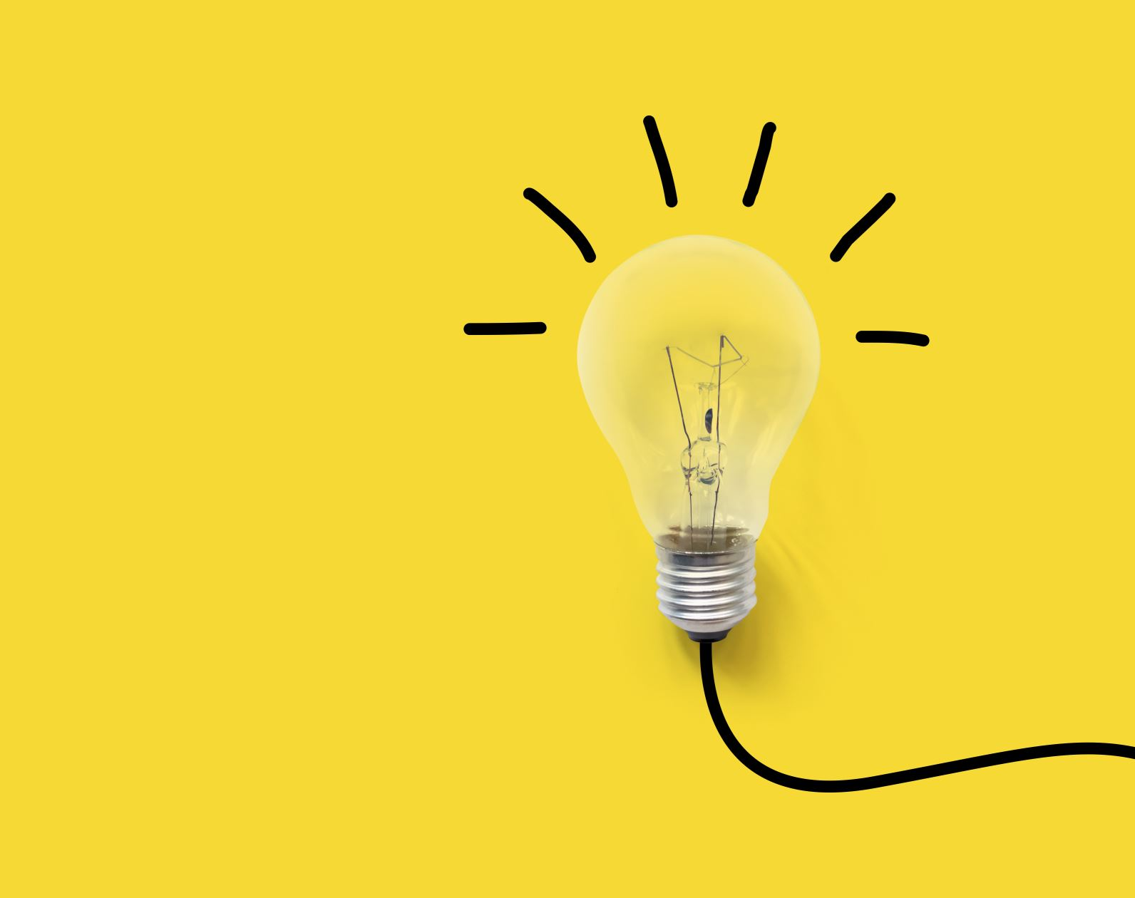
Premise
Clarifying Responsibilities for:
Reads (Queries)
Writes (Commands)
This changes state, so rule enforcement matters
Unit of Work
Aggregates
Domain Events

Slide 15
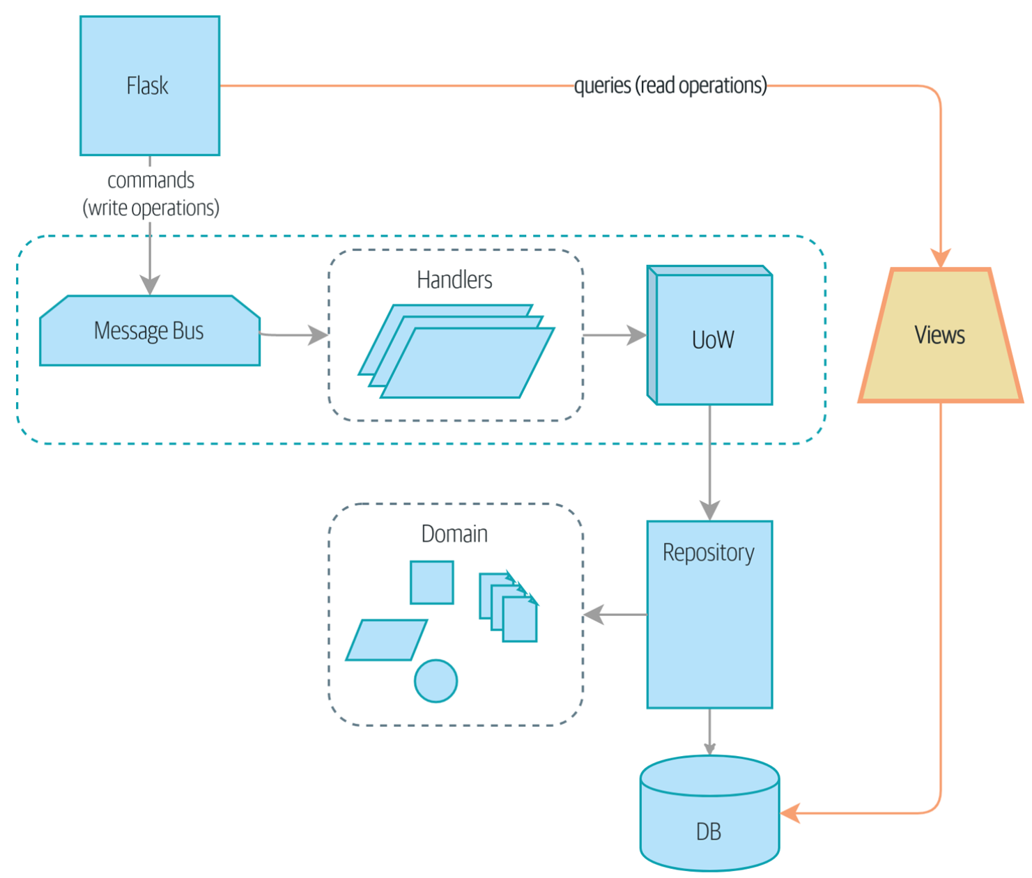

Slide 16
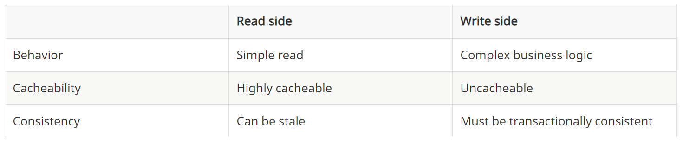
Reads Far Outnumber Writes
Writes MUST be consistent
Reads MUST EVENTUALLY be consistent
Read vs. Write

Slide 17
Post/Redirect/Get
Most transactions designed to write in an HTTP transaction happen this way:
You POST data from a webform/client to the HTTP server for presumed rule-enforcement and data writing
The code that processed the POST redirects you to a follow-on page
The client/browser GETs that page.
This flow, is reflective of Command-Query Separation
We follow one simple rule: functions should either modify state or answer questions, but never both

Slide 18
The Domain Model is not Read Optimized
A domain model is designed to capture verbs and workflow
State changes and why
Causal messages
Aggregate concerns

Slide 19
From CRUD to Domain
This justification for CQRS is related to the justification for the Domain Model pattern.
If you’re building a simple CRUD app, reads and writes are going to be closely related, so you don’t need a domain model or CQRS.
But the more complex your domain, the more likely you are to need both.
Barky DOES NOT have a complex domain
It is likely to benefit most from the O/RM approach taken
Thus, an O/RM is better suited for CRUD apps
Most apps ARE CRUD apps (I’d say Pareto-level distribution)

Slide 20
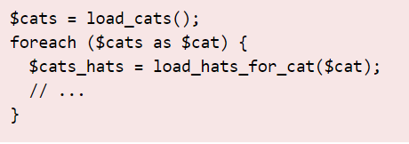
O/RM Weakness: Select N+1
load_cats() is “SELECT * FROM cat WHERE ...”
load_hats_for_cat($cat) is “SELECT * FROM hat WHERE catID = ...”
Problem: It is much faster to issue 1 query which returns 100 results than to issue 100 queries which each return 1 result.

Slide 21
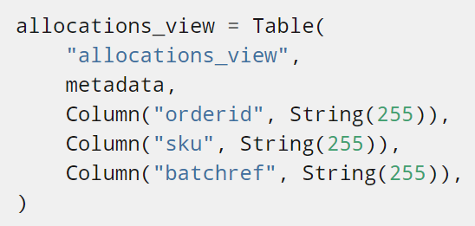
Denormalization
building a denormalized copy of your data that’s optimized for read operations isn’t uncommon, once you’ve reached the limits of what you can do with indexes
Joins are costly
For reads, you need speed
For writes, you need it to be right

Slide 22
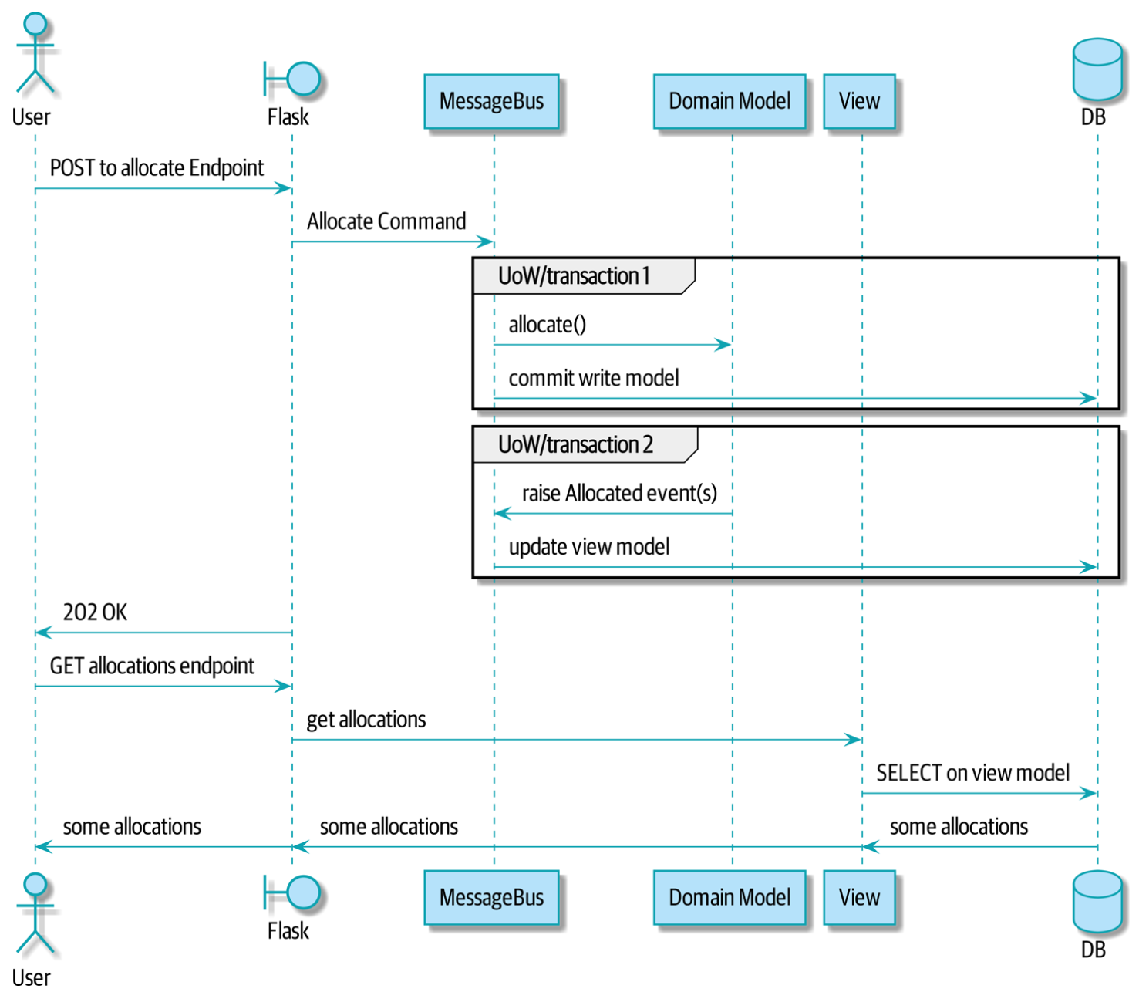
Sequence for Read Model

Slide 23
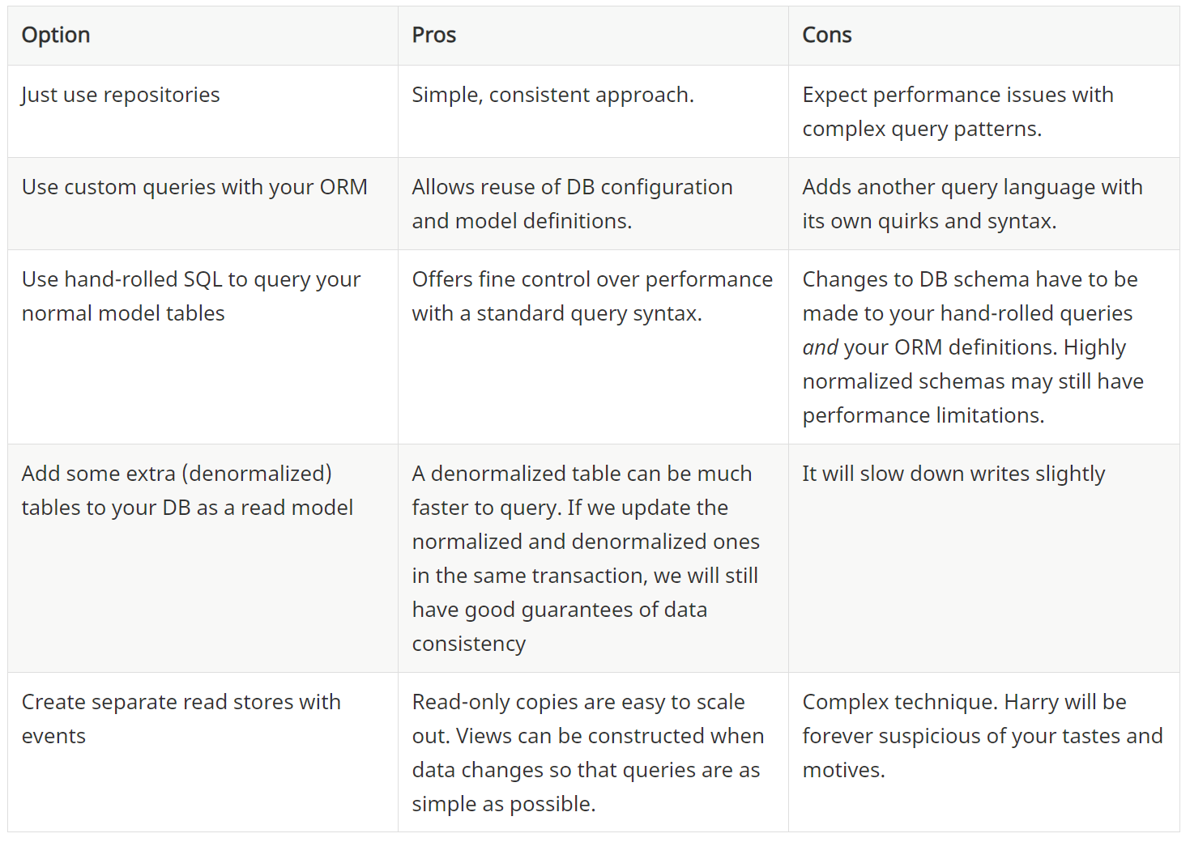
Considering Circumstances and Choices

Slide 24
Dependency Injection
Chapter 13

Slide 25
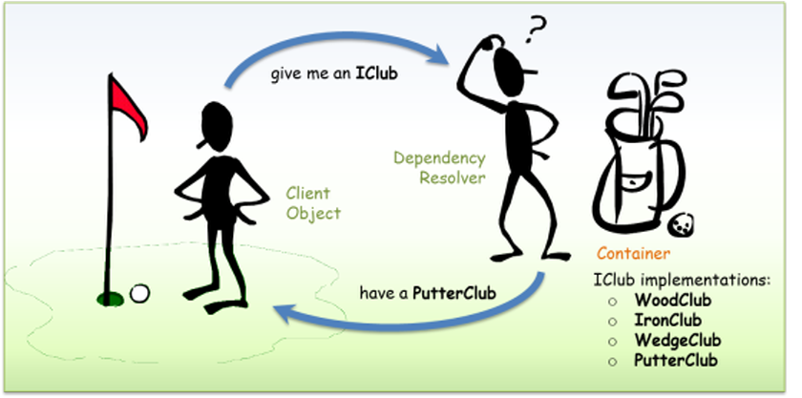
De-complexing with DI

Slide 26
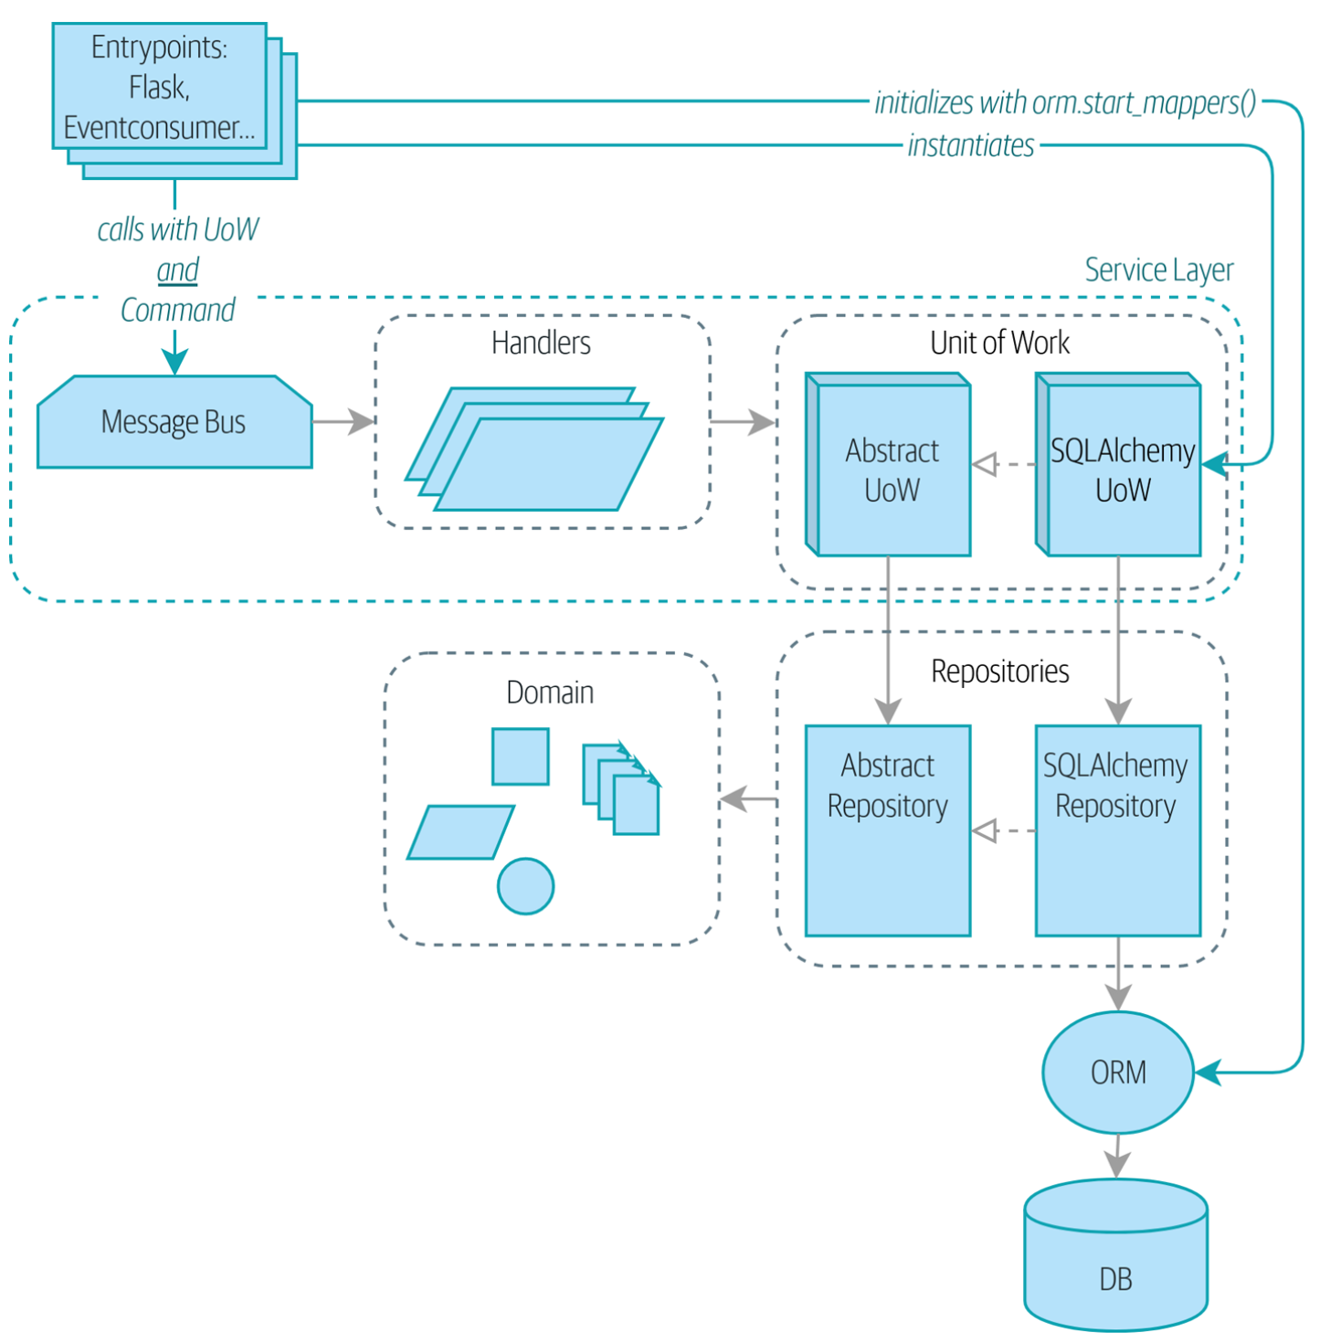
Entry Points

Slide 27
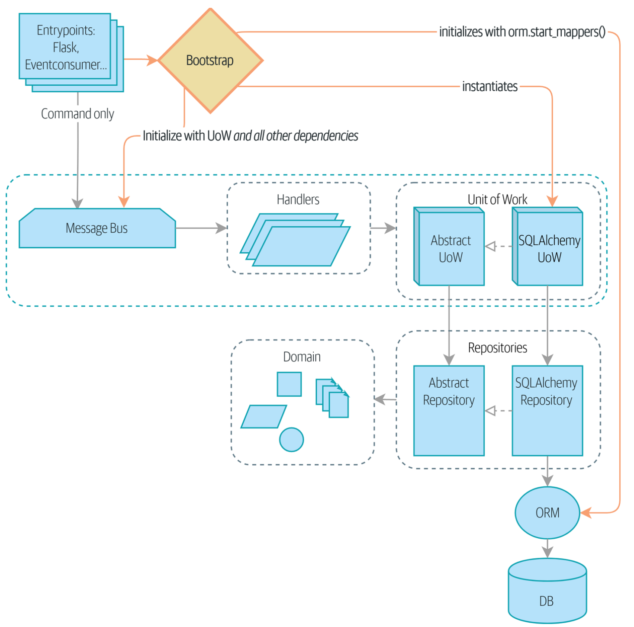
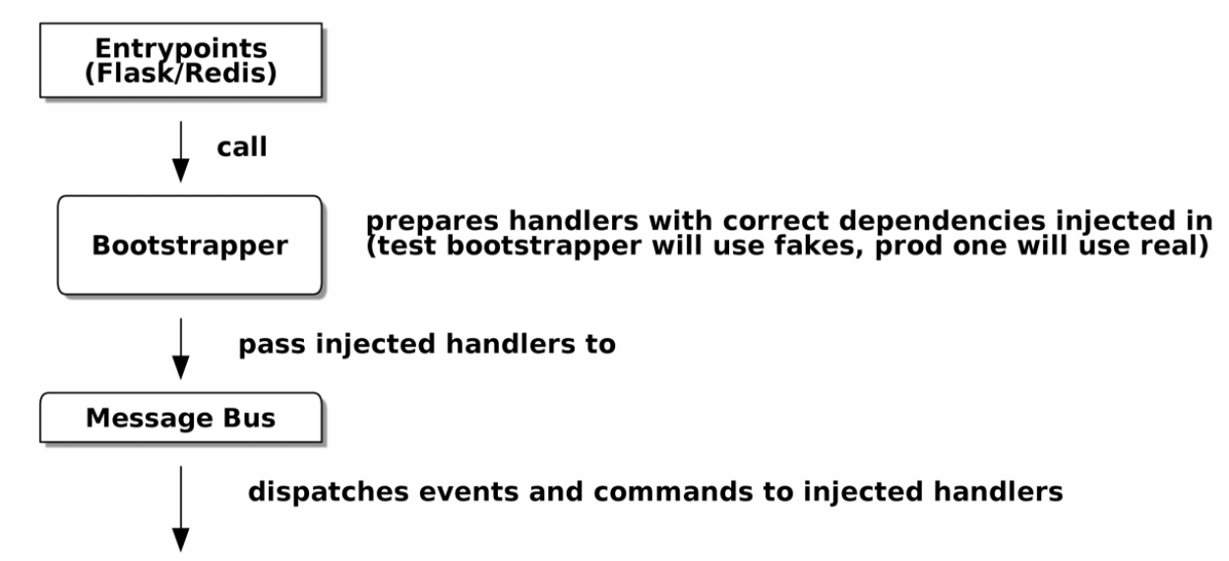
Bootstrapping
Composition Root
The bootstrap is a manual process

Slide 28
What the Bootstrap does
Declare default dependencies but allow us to override them
Do the "init" stuff that we need to get our app started
Inject all the dependencies into our handlers
Give us back the core object for our app, the message bus

Slide 29
Useful additional concepts
Interfaces and Adapters
Abstract and Concrete
Recap:
Define APIs as ABCs
Provide a concrete implementation to fulfill API
Use/Build fakes for testing (unit, E2E, Service-Layers, Handlers)
Use adapters for implementations for testing and deployment
In conjunction with an O/RM

Slide 30
Closing Thoughts
Epilogue

Slide 31
Firehose
Admittedly, the book is a firehose
Not meant for one-pass comprehension
Working from existing frameworks (Django) is more common

Slide 32
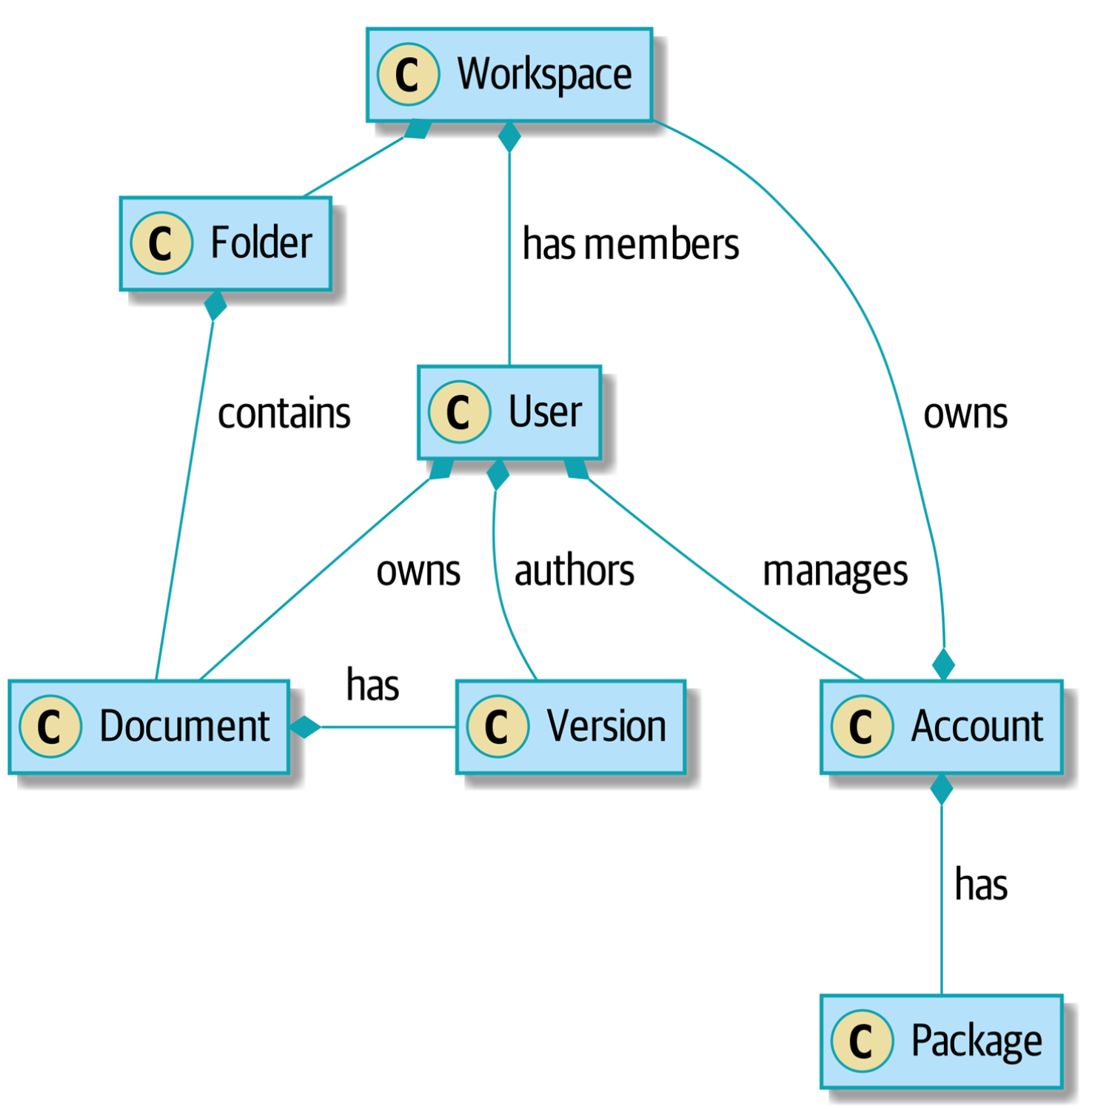
Collaboration of Action (Verbs)

Slide 33
The Process of Architecting
Work out the use cases/user stories of the system
Name each “Update Bookmark”
Each Use Case should:
Start its own persistence/DB transaction (if needed)
Fetch required data
Check preconditions and rules
Update the domain model
Persist any changes
Succeed or fail atomically

Slide 34
The Efficacy of Use Cases
Put these into the use case methods/classes:
Data access and I/O
Orchestration
Error Handling
Logging
Benefit
Separation of concerns
Reveals what the system DOES

Slide 35
Boundaries and Groupings
Aggregates are a consistency boundary.
In general, each use case should update a single aggregate at a time.
One handler fetches one aggregate from a repository, modifies its state, and raises any events that happen as a result.
If you need data from another part of the system, it’s totally fine to use a read model, but avoid updating multiple aggregates in a single transaction.
When we choose to separate code into different aggregates, we’re explicitly choosing to make them eventually consistent with one another.

Slide 36
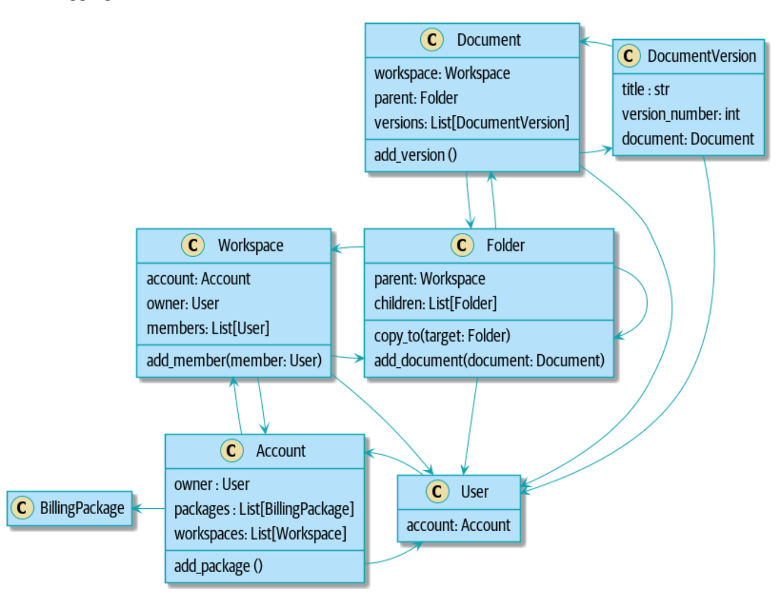
Without Aggregates

Slide 37
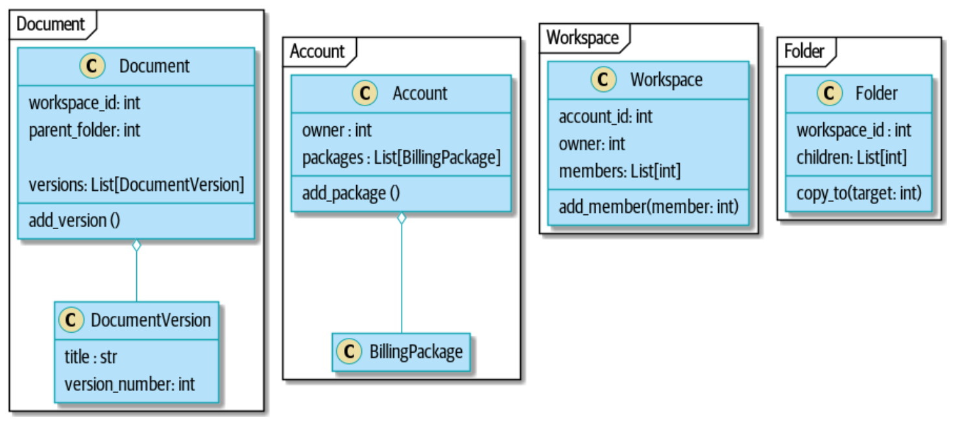
With Aggregates

Slide 38
Refactor towards Loose Coupling
Bits of old functionality are gradually intercepted and replaced, until the old system is left doing nothing at all and can be switched off
Event Interception (what is being said, from whom and to whom?)
Raise events to represent the changes happening in a system you want to replace.
Build a second system that consumes those events and uses them to build its own domain model.
Replace the older system with the new.

Slide 39
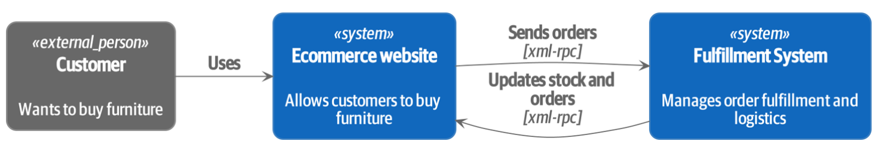
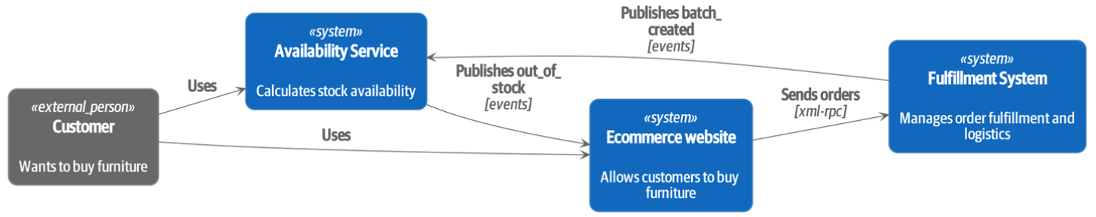
Authors’ Example

Slide 40
Mea Culpas
Firehose?
Yes, reengage in bits and fits
Extracting Use Cases
Might break things, but it is worth it (copy-and-paste your way through)
CQRS, Repositories, Event Sourcing, which is “Right?”
Each are common evolved solutions – there’s no silver bullet
Use Cases Interaction
Message bussing is still the way (commands, queries, events, etc)
Use Cases and Consistency Boundaries
SRP – an aggregate is the highest collection for changes
Do I have to use microservices?
No

Slide 41
Implementation Advice
Choice of message queue is important in production
Redis is fine, but RabbitMQ, Amazon EventBridge, or Apache Kafka are battle-tested
Units Of Work should detect and report failure
This is your state
Idempotency - Describing an action which, when performed multiple times, has no further effect on its subject after the first time it is performed.
You need to handle/ignore this noise
Event Schema will also change
Document this as you would your Domain Schema

